Slide 1
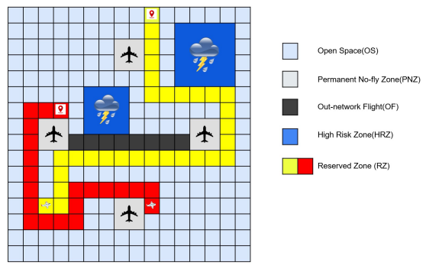
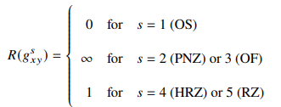
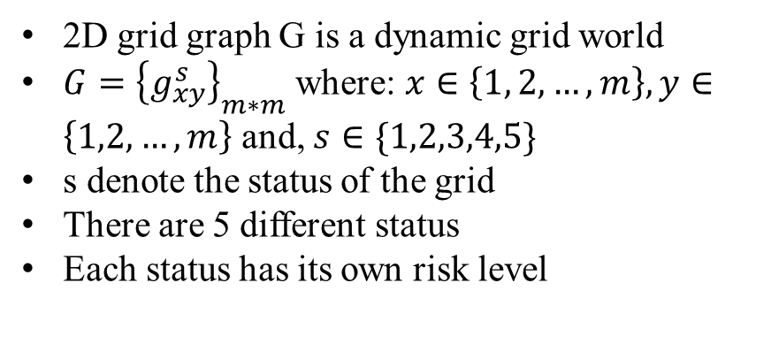
Problem Statement
2D grid graph G is a dynamic grid world
$G={\left\{g_{xy}^{s}\right\}}_{m∗m}$ where: $x∈\left\{1, 2,…,m\right\}, y∈\left\{1,2,…,m\right\}$ and, $s∈\{1,2,3,4,5\}$
s denote the status of the grid
There are 5 different status
Each status has its own risk level
One flight agent occupies one grid cell at each time step, and it can only fly grid cell by grid cell in four directions, i.e., up, left, right, and down and the flight speed is one grid cell per unit of time.

Slide 2
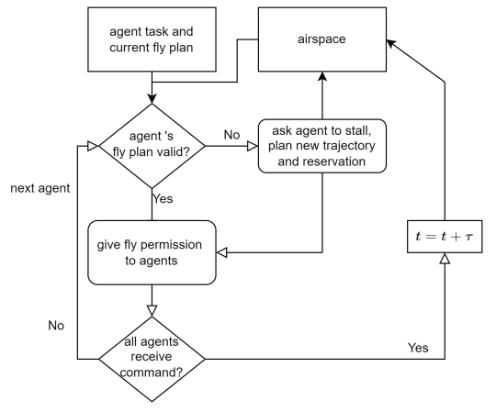
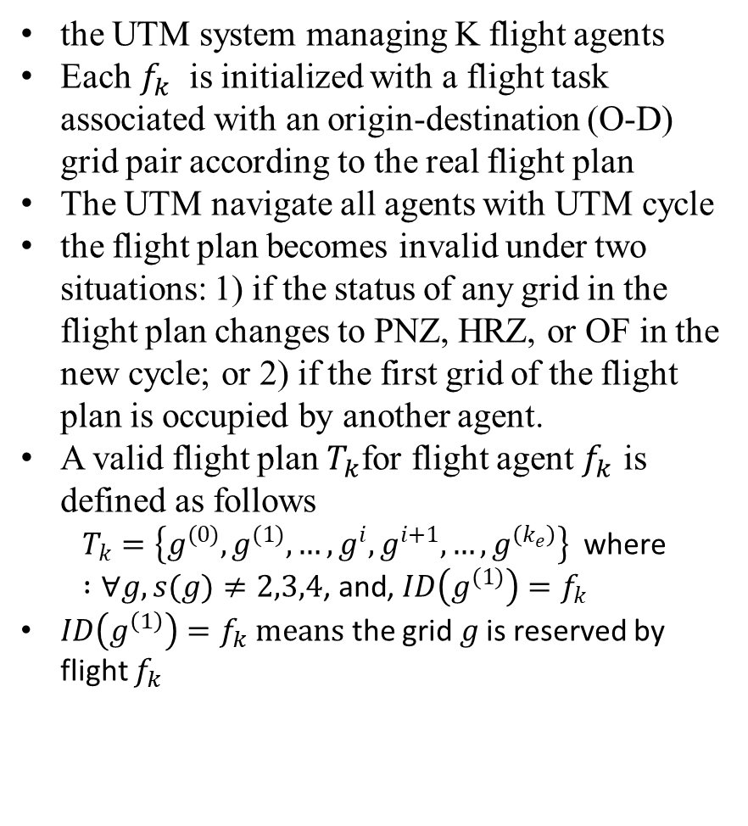
Airspace Management Cycle for UTM
the UTM system managing K flight agents
Each $f_{k}$ is initialized with a flight task associated with an origin-destination (O-D) grid pair according to the real flight plan
The UTM navigate all agents with UTM cycle
the flight plan becomes invalid under two situations: 1) if the status of any grid in the flight plan changes to PNZ, HRZ, or OF in the new cycle; or 2) if the first grid of the flight plan is occupied by another agent.
A valid flight plan $T_{k}$for flight agent $f_{k}$ is defined as follows
$$T_{k}=\left\{g^{(0)},g^{(1)},…,g^{i},g^{i+1},…,g^{\left(k_{e}\right)}\right\} \text{where} :∀g,s(g)≠2,3,4\text{, }\text{and}\text{, }ID\left(g^{(1)}\right)=f_{k}$$
$ID\left(g^{\left(1\right)}\right)=f_{k} means$ the grid 𝑔 is reserved by flight $f_{k}$

Slide 3
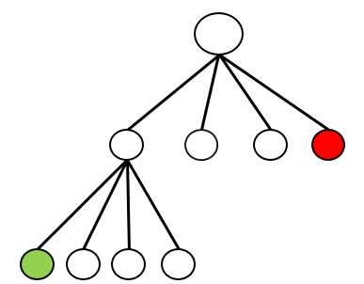
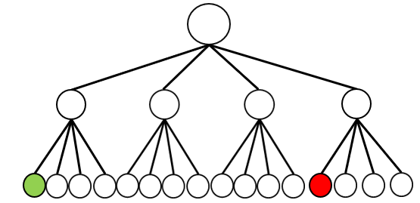
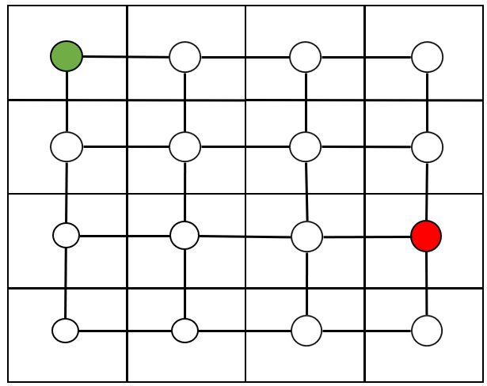
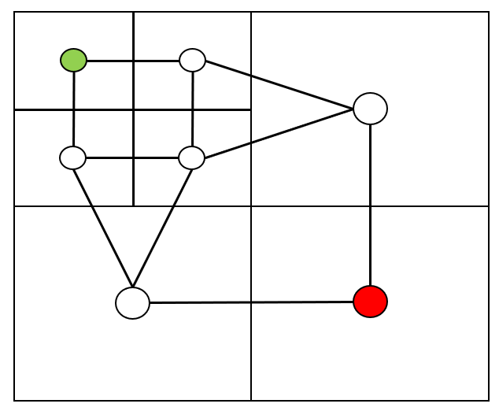
Multi-Resolution Graph with Quadtree
Full Resolution
Multi- Resolution

Slide 4
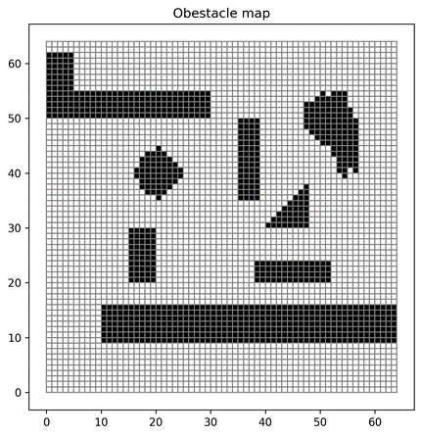
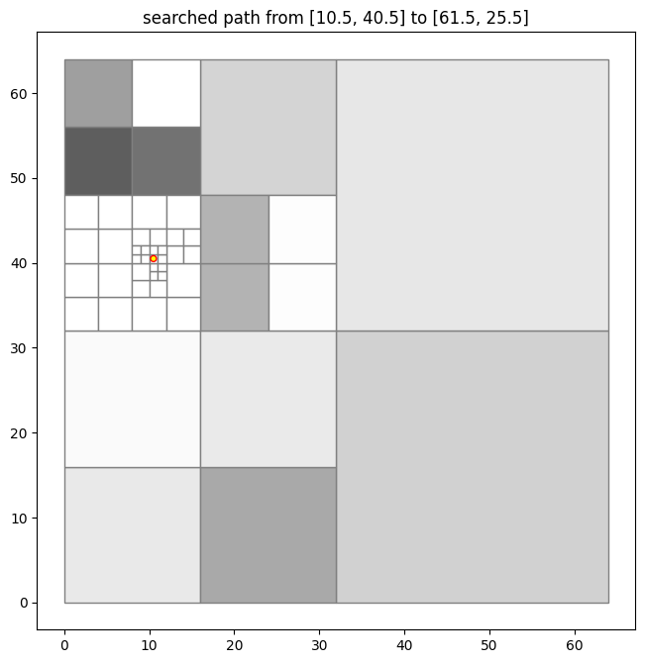
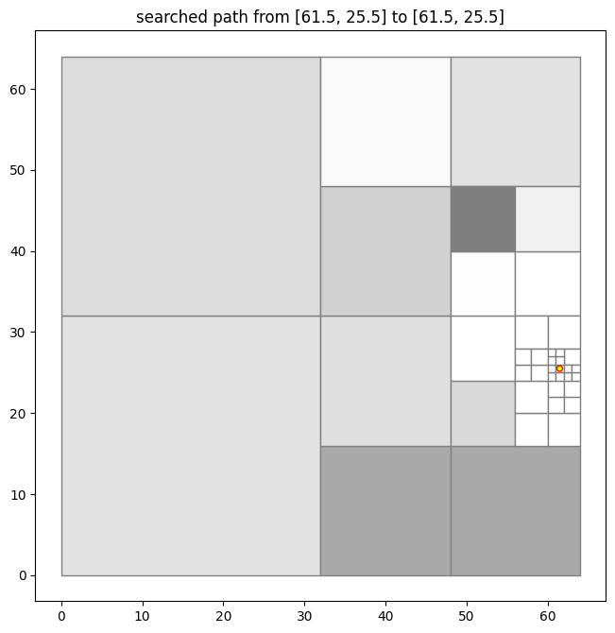
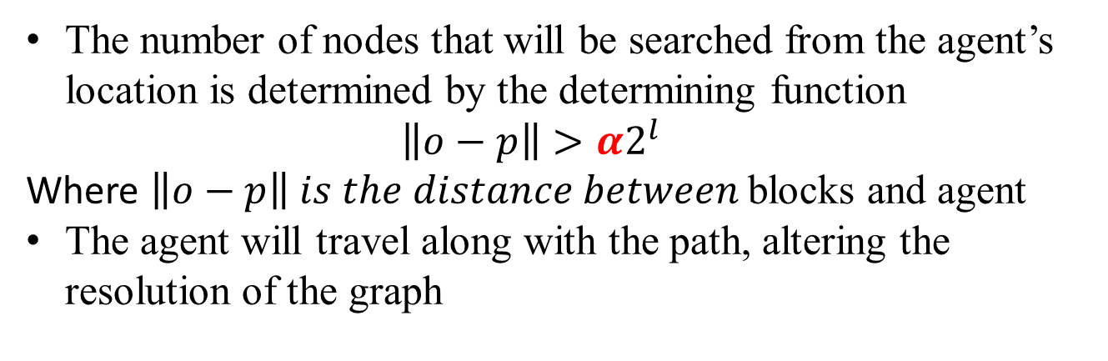
Multi-Resolution Graph Example
Grayscale represents the average risk value in a big block
Full resolution
Multi-resolution graph
The number of nodes that will be searched from the agent’s location is determined by the determining function $\left\|o−p\right\|>α2^{l}$
Where $\left\|o−p\right\| is the distance between$blocks and agent
The agent will travel along with the path, altering the resolution of the graph

Slide 5
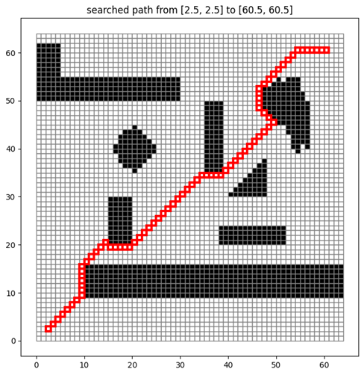
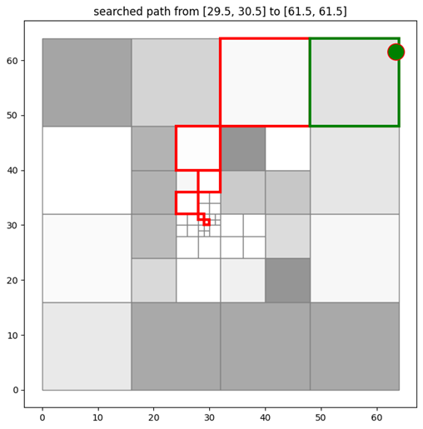
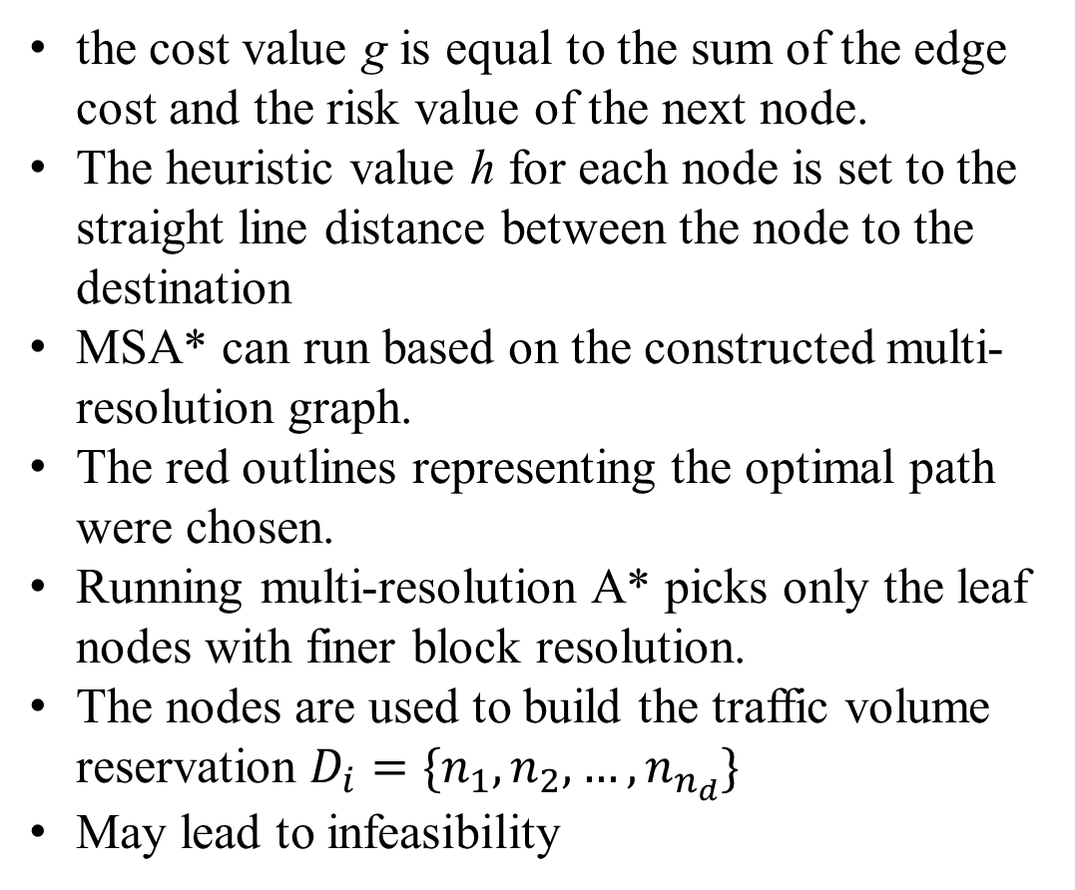
Multi-Scale A*(MSA*)
the cost value g is equal to the sum of the edge cost and the risk value of the next node.
The heuristic value h for each node is set to the straight line distance between the node to the destination
MSA* can run based on the constructed multi-resolution graph.
The red outlines representing the optimal path were chosen.
Running multi-resolution A* picks only the leaf nodes with finer block resolution.
The nodes are used to build the traffic volume reservation $D_{i}=\{n_{1},n_{2},…,n_{n_{d}}\}$
May lead to infeasibility
A* in a full resolution map
MSA* in a multi-resolution graph

Slide 6
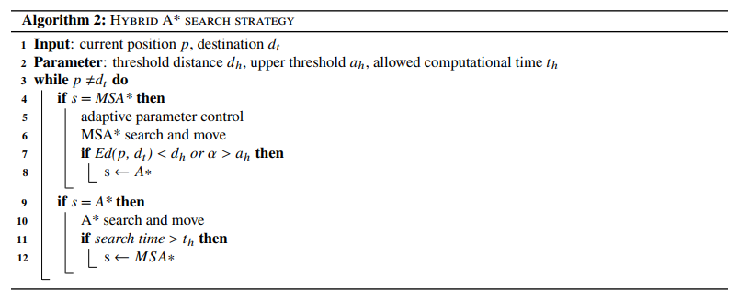
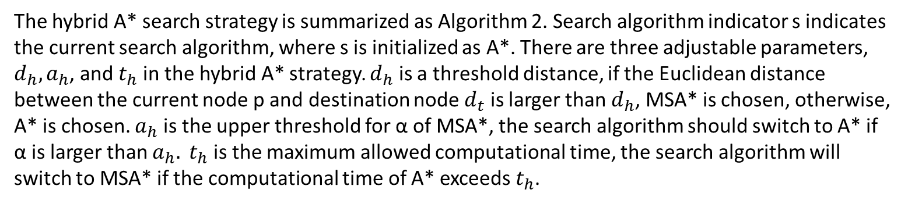
Hybrid A* Search Strategy
The hybrid A* search strategy is summarized as Algorithm 2. Search algorithm indicator s indicates the current search algorithm, where s is initialized as A*. There are three adjustable parameters, $d_{h}, a_{h}$, and $t_{h}$in the hybrid A* strategy. $d_{h}$ is a threshold distance, if the Euclidean distance between the current node p and destination node $d_{t}$ is larger than $d_{h}$, MSA* is chosen, otherwise, A* is chosen. $a_{h}$ is the upper threshold for α of MSA*, the search algorithm should switch to A* if α is larger than $a_{h}. t_{h}$ is the maximum allowed computational time, the search algorithm will switch to MSA* if the computational time of A* exceeds $t_{h}$.

Slide 7
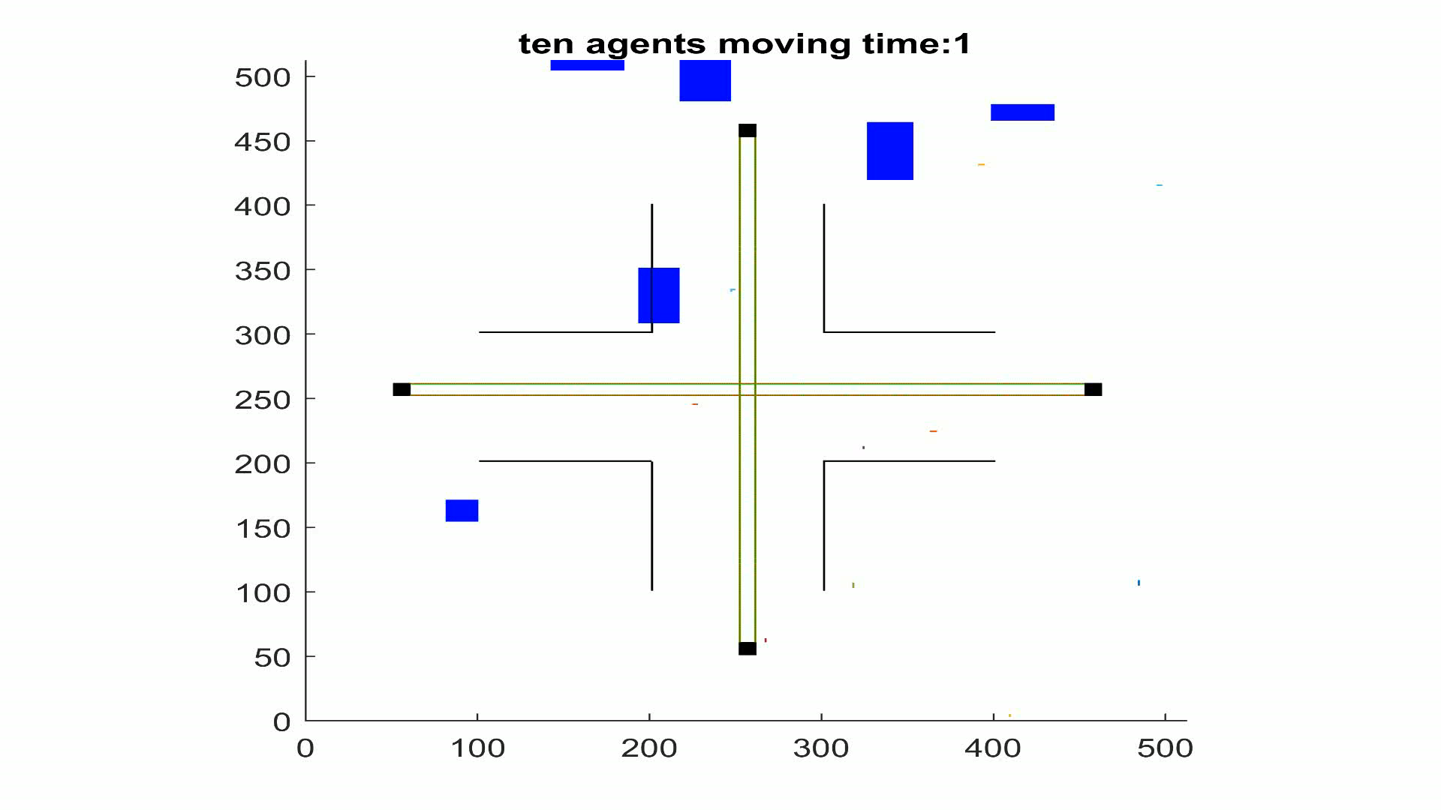

Slide 8
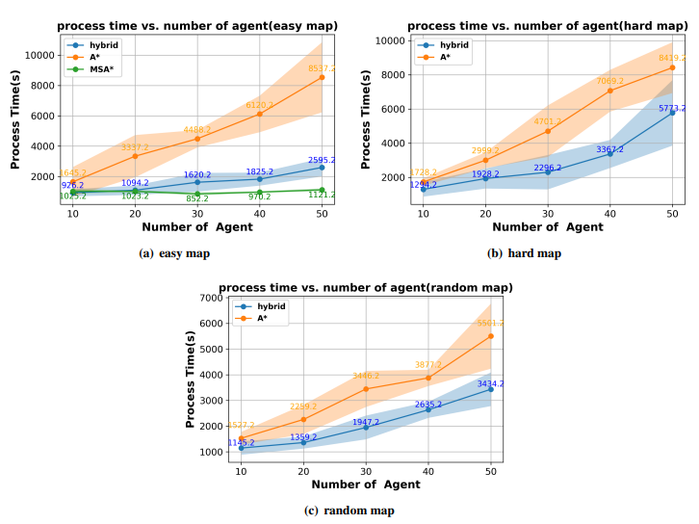
Results: A* vs. hybrid A*

Slide 9
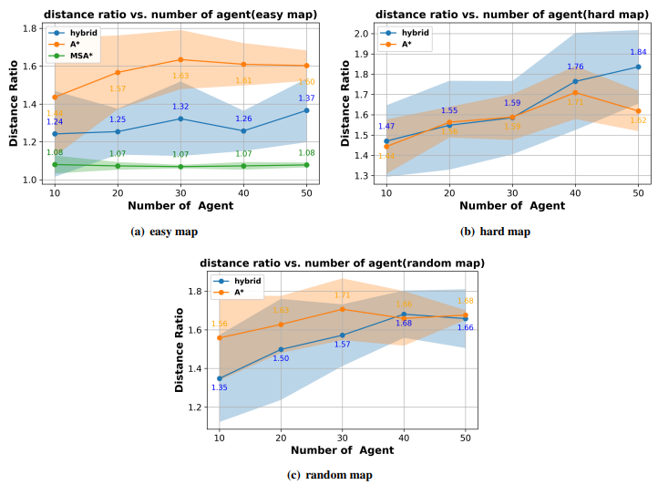
Results: distance ratio

Slide 10
Conclusion and Future Implementation
Conclusion:
The major advantage of the multi-scale A* algorithm is the ability to effectively decrease the size of the search space for the A* algorithm while keeping essential map information.
To overcome the corner cases of the multi-scale A*, we propose a hybrid strategy that combines full-resolution A* to help agents jump out of the dead-end.
This hybrid planning strategy is shown to be significantly faster than pure A* planning while maintaining a 100% success rate in various test cases.
Future:
This concept can further be implemented in a 3D real time city with high density air traffic

